Slide 1







CHROME EXTENSION FOR SAFER WHATSAPP MESSAGING
A SMART ASSISTANT FOR DETECTING SENSITIVE
OR RISKY MESSAGES ON WHATSAPP WEB
Shahar Shem Tov
Sara Benita
Aviv Natan

Slide 2


WHAT IS THE PROJECT ABOUT?
•A Chrome extension that helps users reflect on messages after they are sent on WhatsApp Web.
•Messages are sent to our backend, analyzed by OpenAI.
•If a message is risky, a warning and explanation are shown to the user.
•Built for anyone who wants help communicating more safely – including older adults, parents, or grandparents.

Slide 3
We will show:
1. The user needs to log in.
2. If it’s their first time using the extension:
– They’re asked to create an account.
– They’re asked to agree to the terms of use.
3. Otherwise, they can simply log in directly.
LIVE DEMO
HOW OUR SYSTEM WORKS

Slide 4
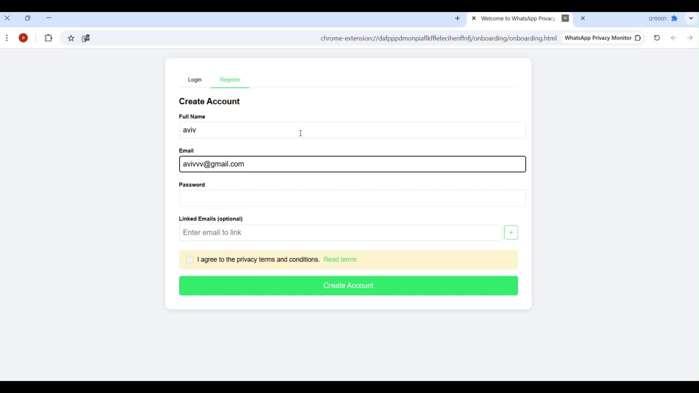

Slide 5

MAIN FEATURE
1. User sends a message on WhatsApp Web.
2. Extension captures the outgoing message via content script.
3. Message is sent to the server.
4. Backend analyzes it using OpenAI.
5. If risky, a popup is shown with the category and a short explanation.

Slide 6
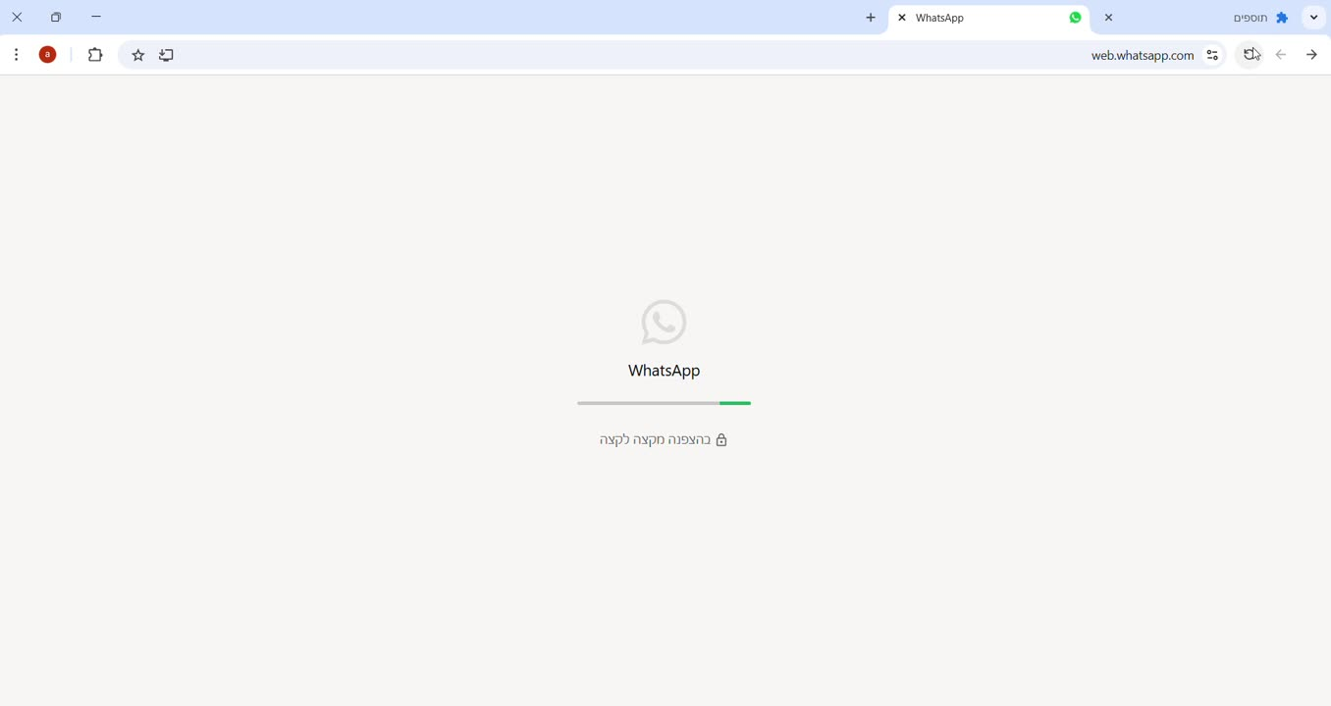

Slide 7

TECHNOLOGIES USED
•Frontend: Chrome Extension (HTML, JavaScript)
•Backend: Node.js with Express
•AI Integration: OpenAI API
•Database: MongoDB
•Security: CryptoJS for basic encryption and JWT

Slide 8


DEVELOPMENT PROCESS
Explored WhatsApp Web and figured out how to detect outgoing messages.
Built a content script to capture messages from the interface.
Integrated OpenAI with a custom prompt to classify messages.
Connected to MongoDB to store users and message data.
Added login & registration with privacy notice and user agreement.
Secured the system using JWT-based authentication

Slide 9

CHALLENGES
•WhatsApp Web DOM is dynamic and changes often.
•Choosing the right method to analyze messages:
– Initially trained a custom model using HuggingFace.
– Switched to OpenAI for more accurate and nuanced results.
•Designing clear and helpful feedback for users in real time.

Slide 10
WHAT’S NEXT?
•Currently, the user gets feedback only if WhatsApp Web is open and focused on the specific chat where the message is sent.
•We aim to support detection even if the user is not on that chat,
and even if the message is sent from a mobile device, as long as WhatsApp Web is open and the extension is activein the background.
•Build a dashboard with messages history.
•Extend support beyond text: detect risky images and voice messages as well.

Slide 11
THANK YOU!

